Slide 1
CMSC204
Kartchner
V(StateGraph) = {Oregon, Alaska, Texas, Hawaii, Vermont, NewYork, California}
E(StateGraph) = {(Alaska, Oregon), (Hawaii, Alaska), (Hawaii, Texas), (Texas, Hawaii), (Hawaii, California), (Hawaii, New York), (Texas, Vermont), (Vermont, California), (Vermont, Alaska)}
1. Draw the StateGraph
Oregon
Alaska
Texas
Vermont
Hawaii
California
New York

Slide 2
a. Show the adjacency matrix that would describe the edges in the graph. Store the vertices in alphabetical order
to
States
Alaska California Hawaii New York Oregon Texas Vermont
Alaska
California
Hawaii
New York
Oregon
Texas
Vermont
0 0 0 0 1 0 0
0 0 0 0 0 0 0
1 1 0 1 0 1 0
from
0 0 0 0 0 0 0
0 0 0 0 0 0 0
0 0 1 0 0 0 1
1 1 0 0 0 0 0
3. b. Show the adjacency lists
that would describe the edges in the graph
Alaska
California
Hawaii
New York
Oregon
Texas
Vermont
Oregon
Alaska
California
New York
Texas
Hawaii
Vermont
Alaska
California

Slide 3
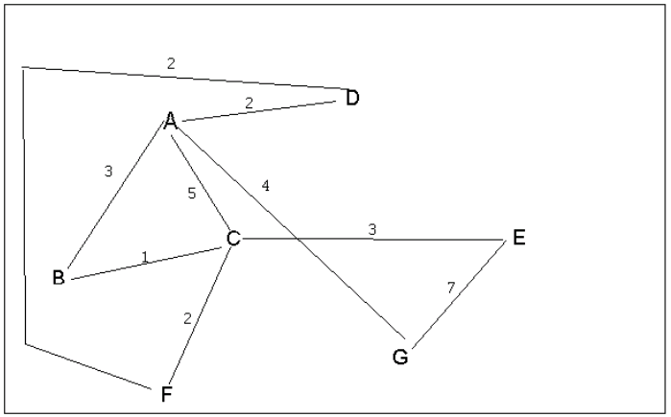
4 a. Which of the following lists the graph nodes in depth first order beginning with E?
A) E, G, F, C, D, B, A
B) G, A, E, C, B, F, D
C) E, G, A, D, F, C, B
D) E, C, F, B, A, D, G
4 b. Which of the following lists the graph nodes in breadth first order beginning at F?
A) F, C, D, A, B, E, G
B) F, D, C, A, B, C, G
C) F, C, D, B, G, A, E
D) a, b, and c are all breadth first traversals

Slide 4
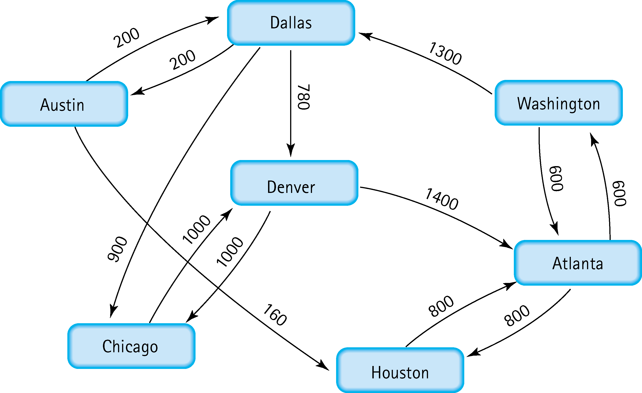
5. Find the shortest distance from Atlanta to every other city
Atlanta – Houston (800)
Atlanta – Washington (600)
Atlanta – Dallas (600 + 1300)
Atlanta – Denver (600 + 1300 + 780)
Atlanta – Austin (600 + 1300 + 200)
Atlanta – Chicago (600 + 1300 + 900)

Slide 5
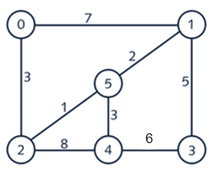
6. Find the minimal spanning tree using Prim’s algorithm. Use
0 as the source vertex . Show the steps.

Slide 6
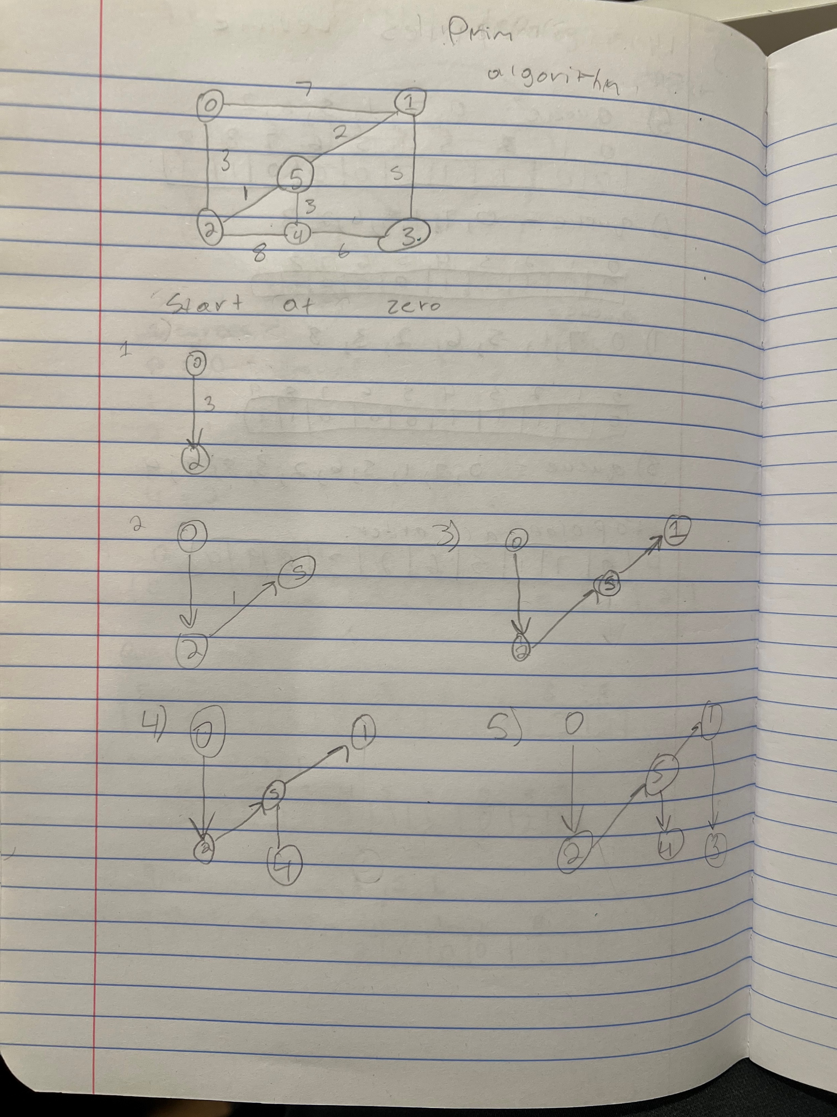

Slide 7
7. Find the minimal spanning tree using Kruskal’s algorithm.
Show the weights in order and the steps.

Slide 8
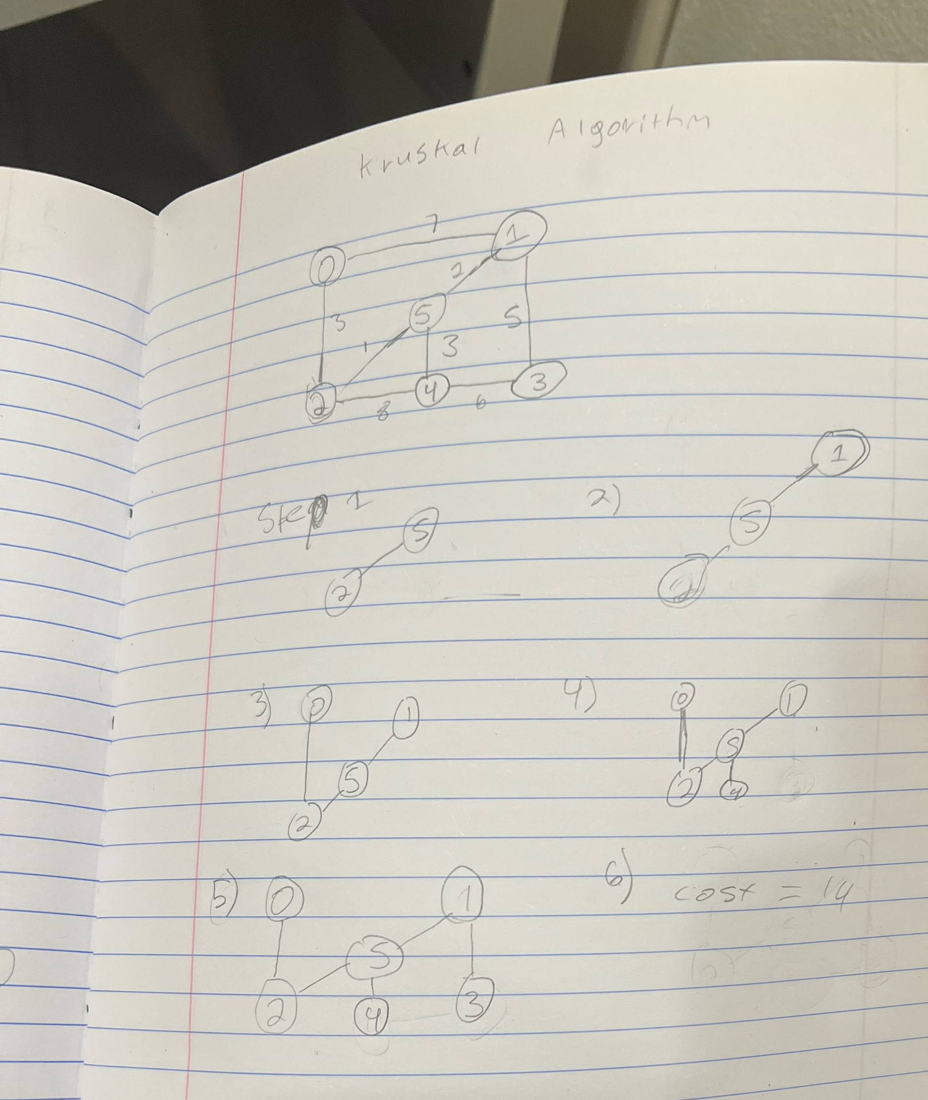

Slide 9
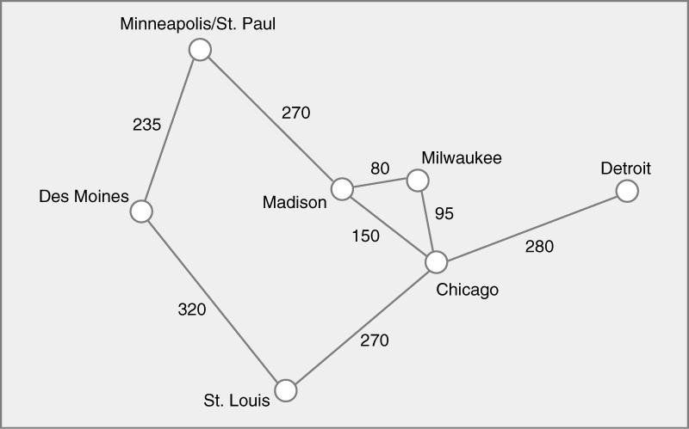
8. Find the minimal spanning tree using the algorithm you prefer. Use
Minneapolis/St. Paul as the source vertex
Kruskal
Madison-Milwaukee (80), Milwaukee-Chicago (95), Chicago-Madison (150), Minneapolis/St. Paul-Des Moines (235), St. Louis-Chicago (270), Minneapolis/St. Paul-Madison (270), Chicago-Detroit (280), Des Moines-St. Louis (320).

Slide 10
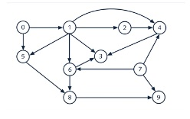
9. List the nodes of the graph in a breadth first topological ordering. Show the
steps using arrays predCount, topologicalOrder and a queue

Slide 11
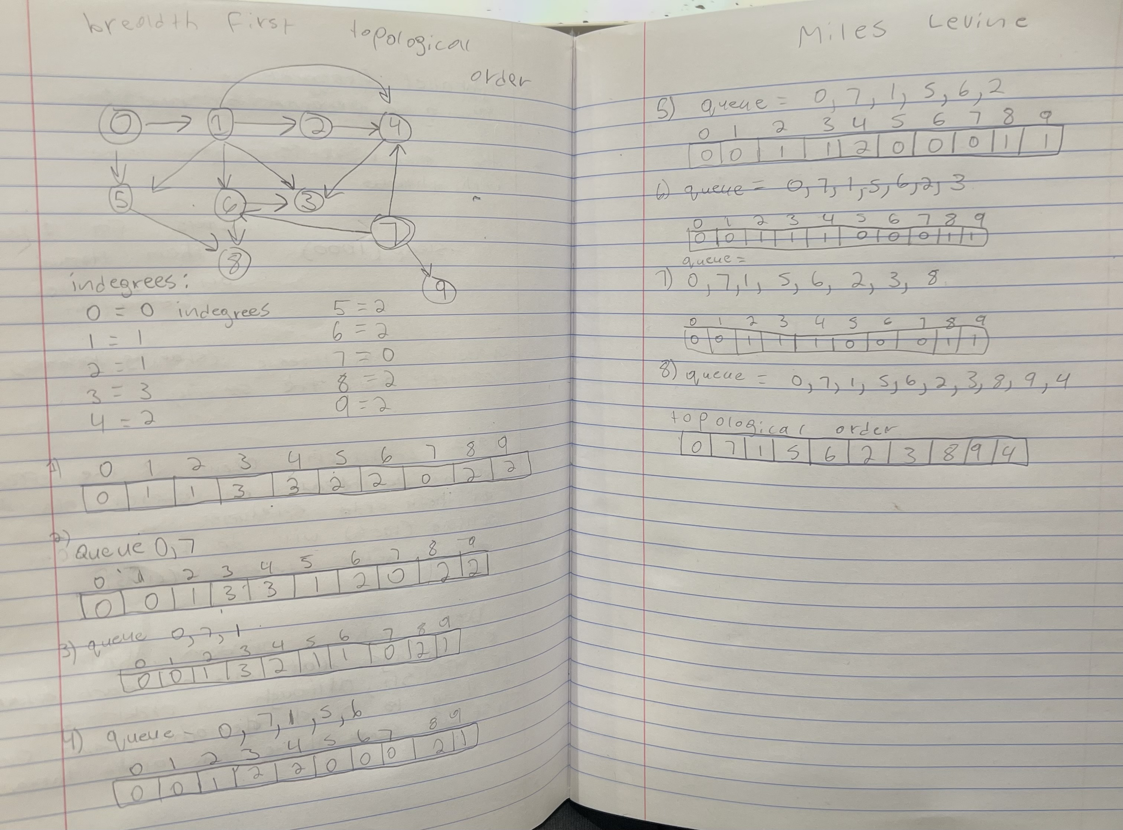

Slide 12

10. List the nodes of the graph in a breadth first topological ordering.
Start, Discrete Math, Programming 1, Programming 2, Computer Organization, Algorithms, High-Level Languages, Operating Systems, Theory Computation, Senior Seminar, Compilers, End

